Slide 1
Cu2Se

Slide 2
Essay about Cu2Se

Slide 3
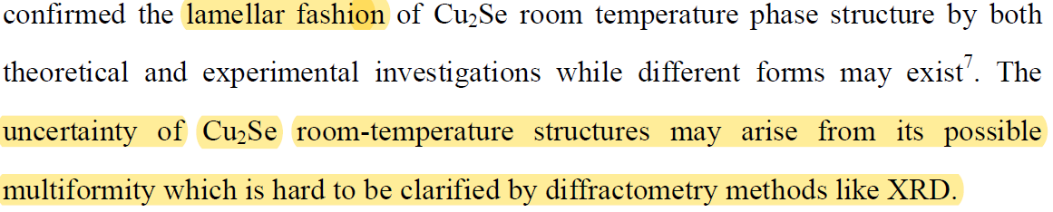
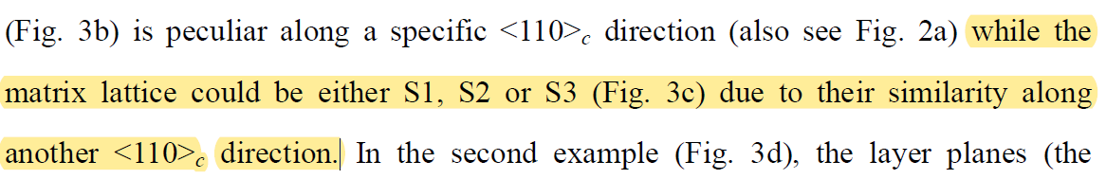
Multiformity and fluctuation of Cu ordering in Cu2Se thermoelectric materials P. Lu, H. Liu, X.Yuan, F. Xu, X. Shi, K. Zhao, W. Qiu, W. Zhang and L. chen, J. Mater. Chem. A, 2015,

Slide 4
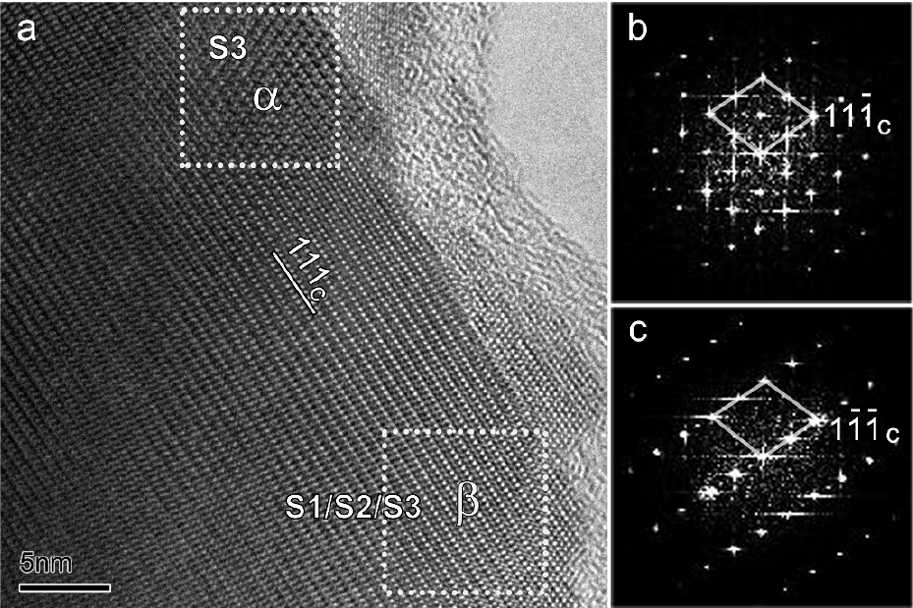
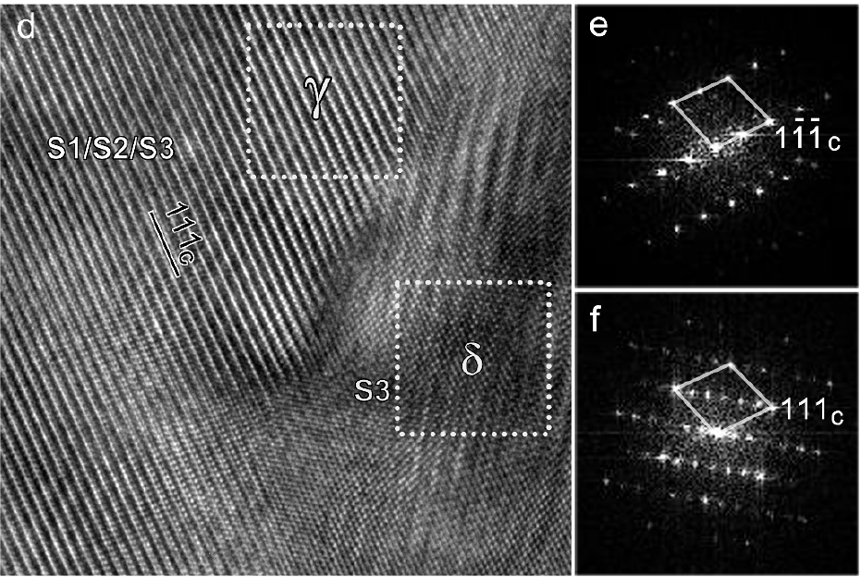
Multiformity and fluctuation of Cu ordering in Cu2Se thermoelectric materials P. Lu, H. Liu, X.Yuan, F. Xu, X. Shi, K. Zhao, W. Qiu, W. Zhang and L. chen, J. Mater. Chem. A, 2015,

Slide 5
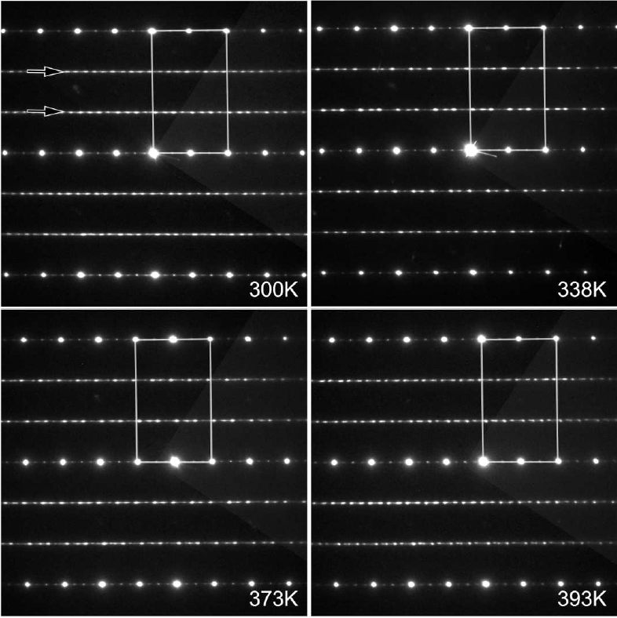
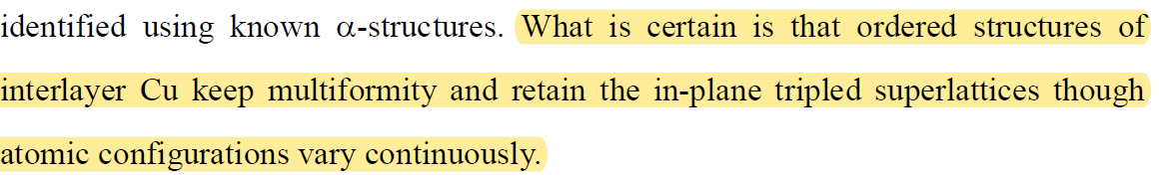
Multiformity and fluctuation of Cu ordering in Cu2Se thermoelectric materials P. Lu, H. Liu, X.Yuan, F. Xu, X. Shi, K. Zhao, W. Qiu, W. Zhang and L. chen, J. Mater. Chem. A, 2015,
S1 Triclinic
S2 Monoclinic
S3 Triclinic
S1x1 Trigonal
Sder1 Monoclinic
Sder2 Monoclinic

Slide 6
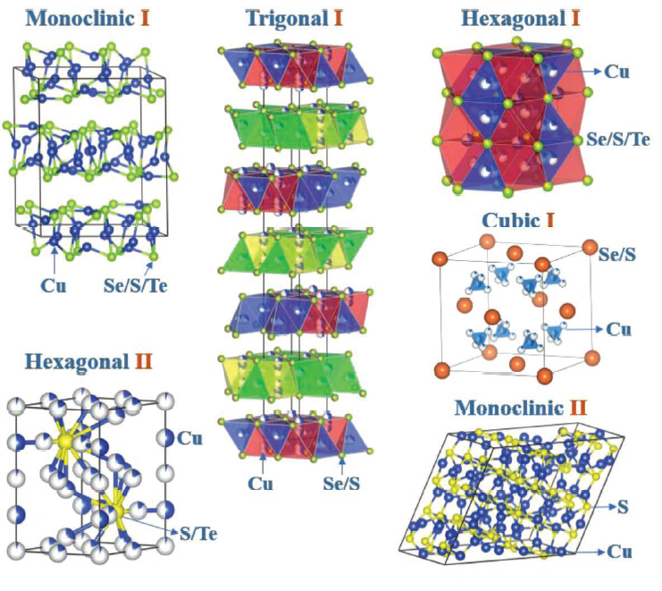

Slide 7
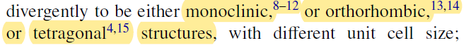
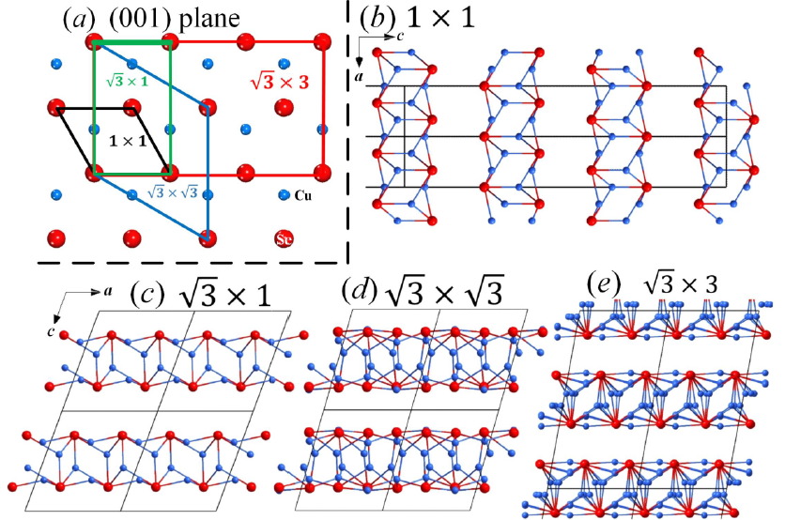
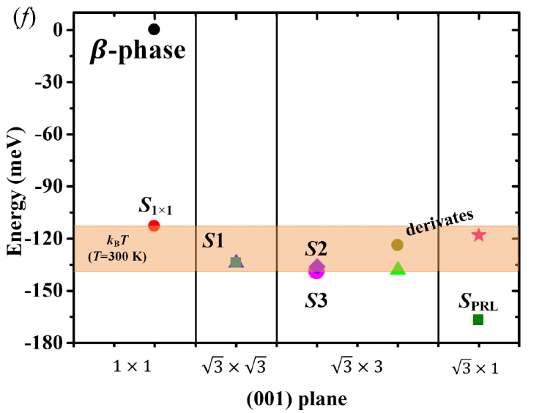
Structure family and polymorphous phase transition in the compounds with soft
sublattice: Cu2Se as an example J. Chem. Phys. 144, 194502 (2016); doi: 10.1063/1.4948609
either trigonal,too
S1X1
Sder1
S1
S2,S3,Sder2

Slide 8
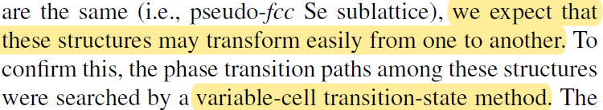
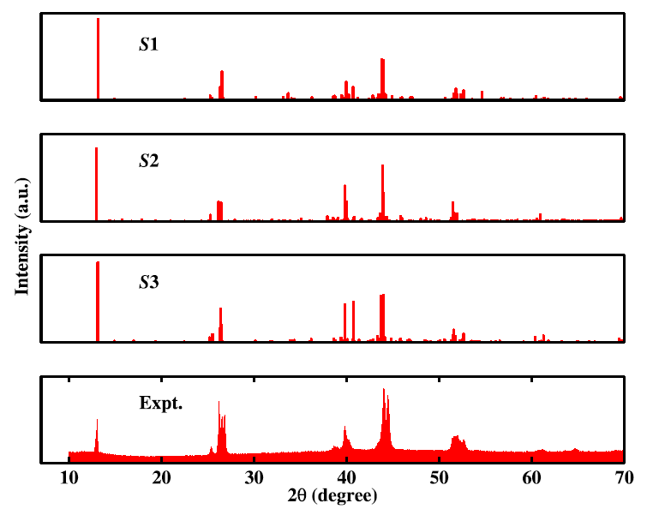
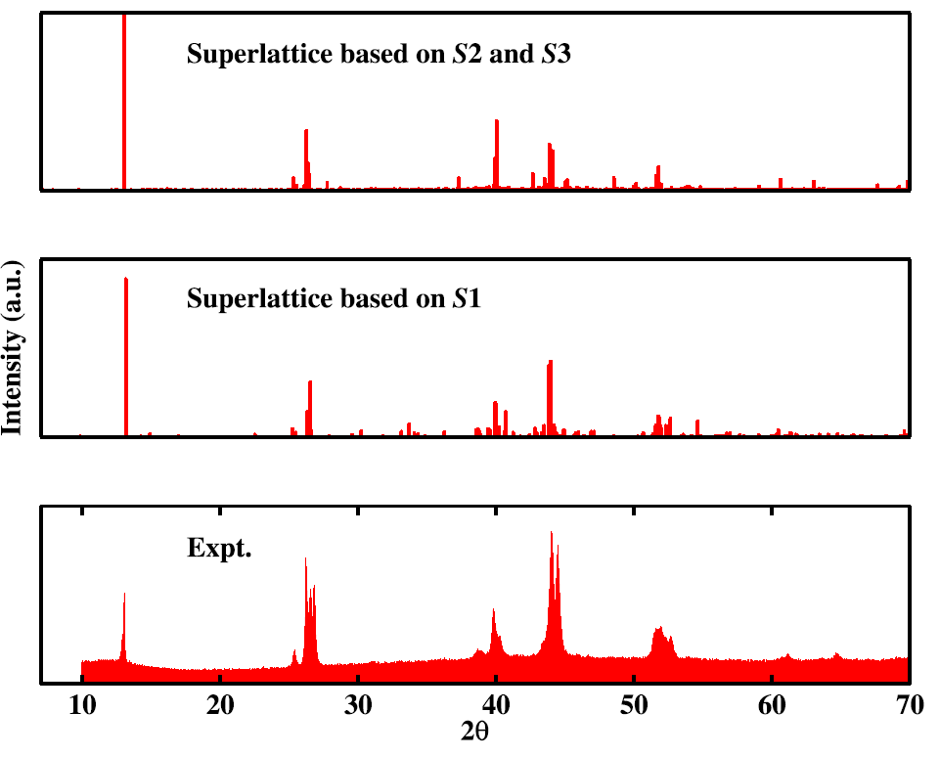

Slide 9
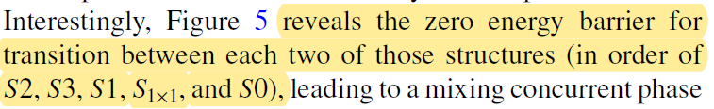
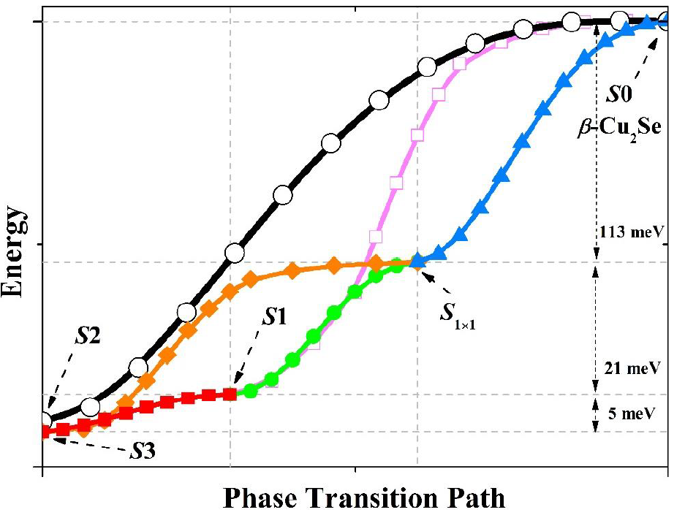

Slide 10
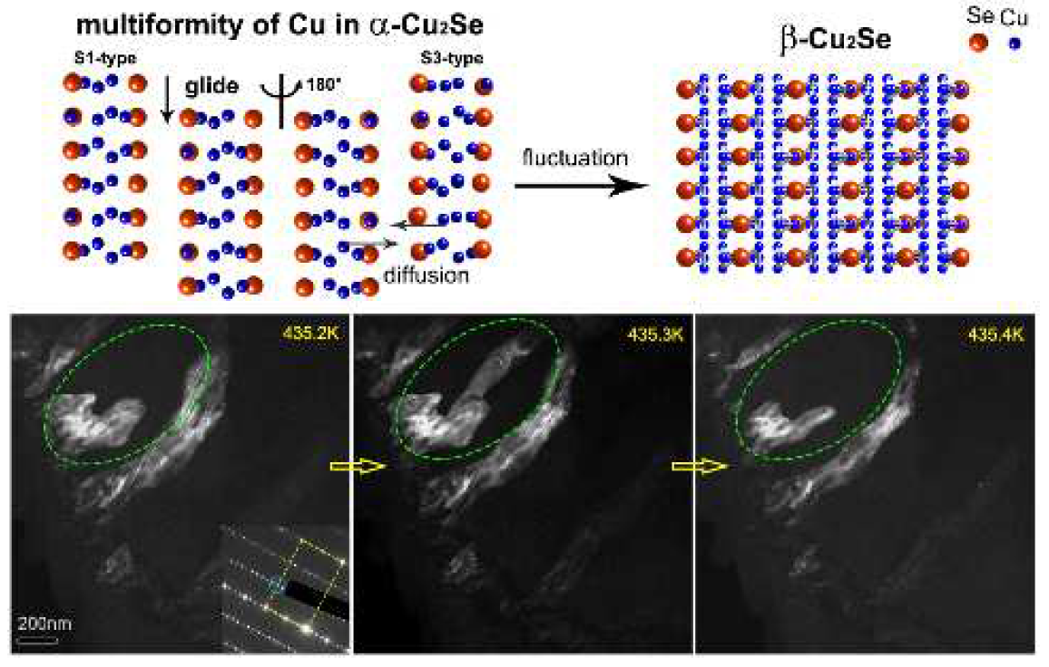

Slide 11
XRD & Current

Slide 12
Anode
Cathode

Slide 13
Anode
Cathode
Maybe Cu(111)
Maybe Cu(200)

Slide 14
Only heating detected on Anode
Phase transform
Be treated
by 3.5Acurrent

Slide 15
Detecting Cathode on current&750K
Cannot find (hkl)
Cannot compare with anode
dspacing(15.8)=5.4567A
dspacing(36.8)=2.3886A

Slide 16
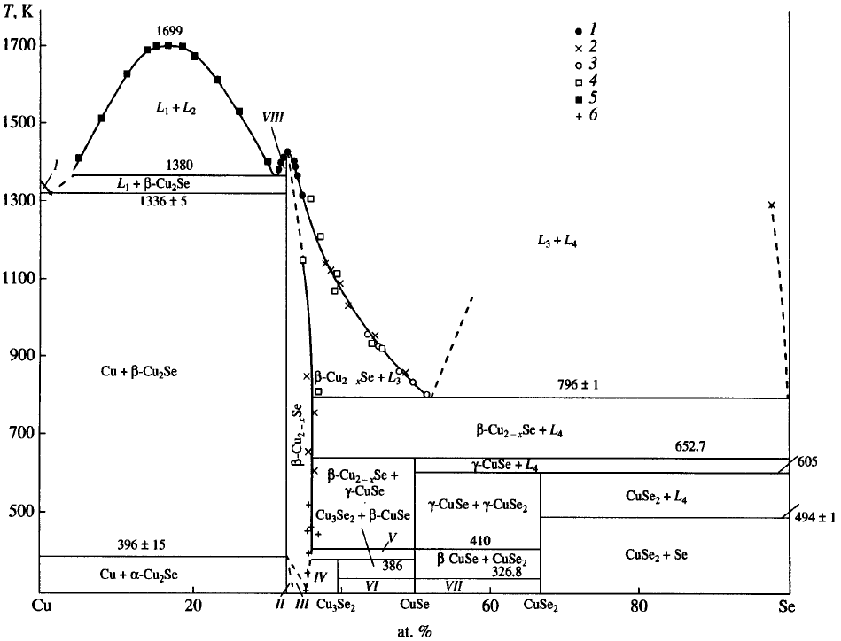
Phase diagram
II Cu2Se

Slide 17
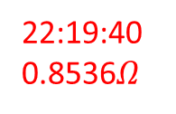
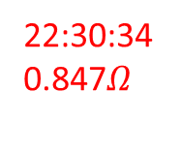
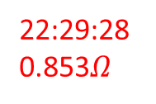
For(3.5A_heating_third_3)
22:19:40 0.8536$Ω$
22:29:28 0.853$Ω$
22:30:34 0.847$Ω$

Slide 18
Anode
Cathode
Cu對不到可能沒有長成晶粒
沒加熱峰值還較高

Slide 19
SEM

Slide 20
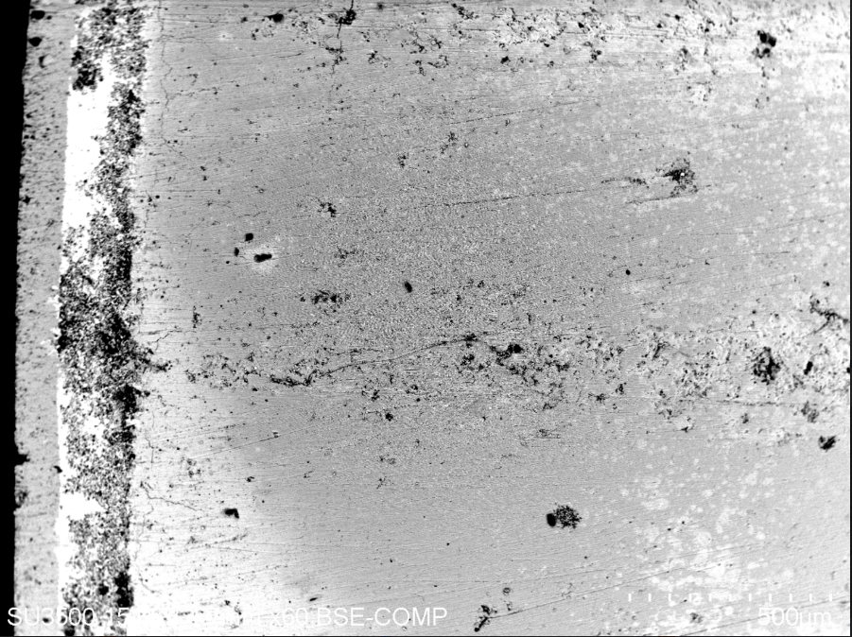
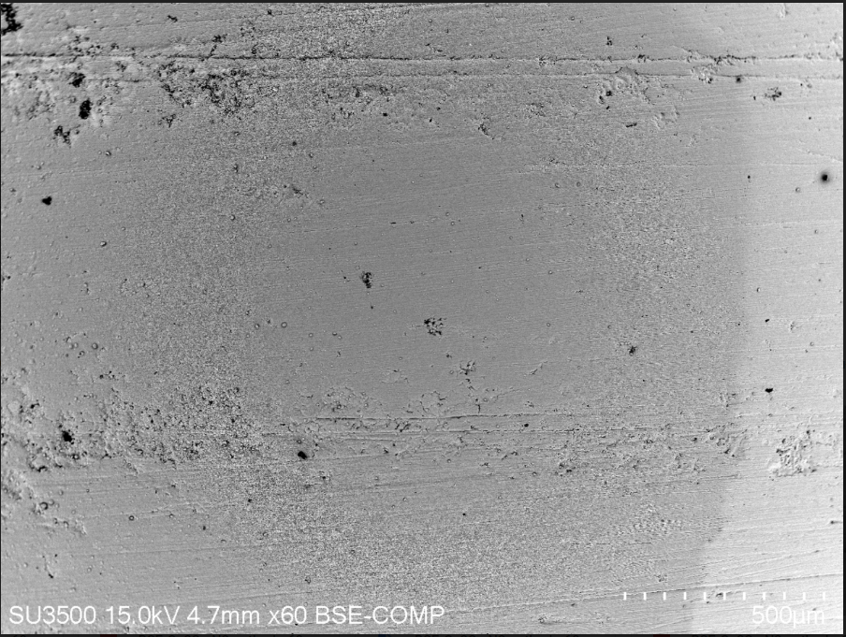
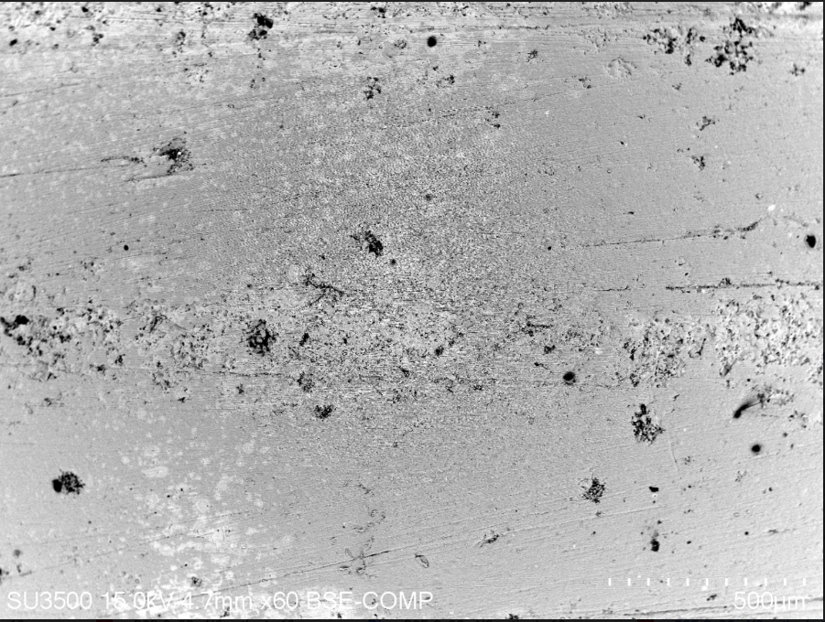
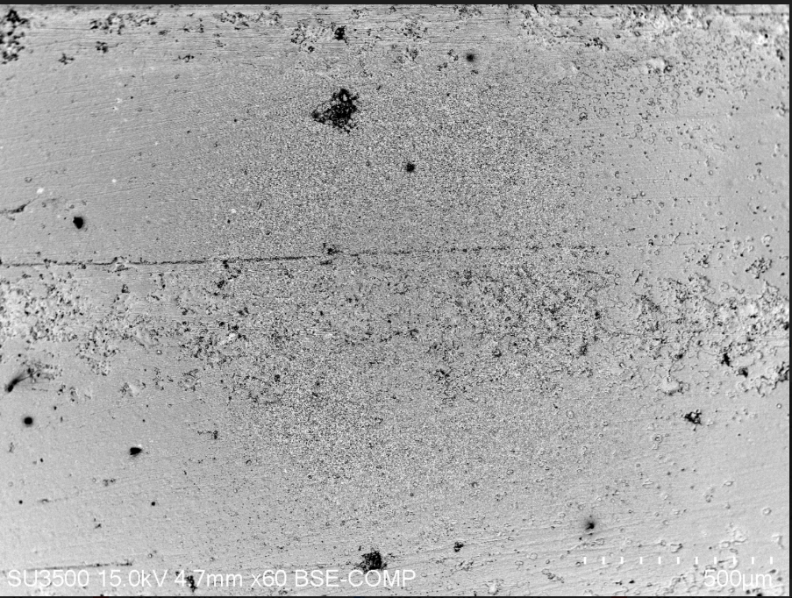
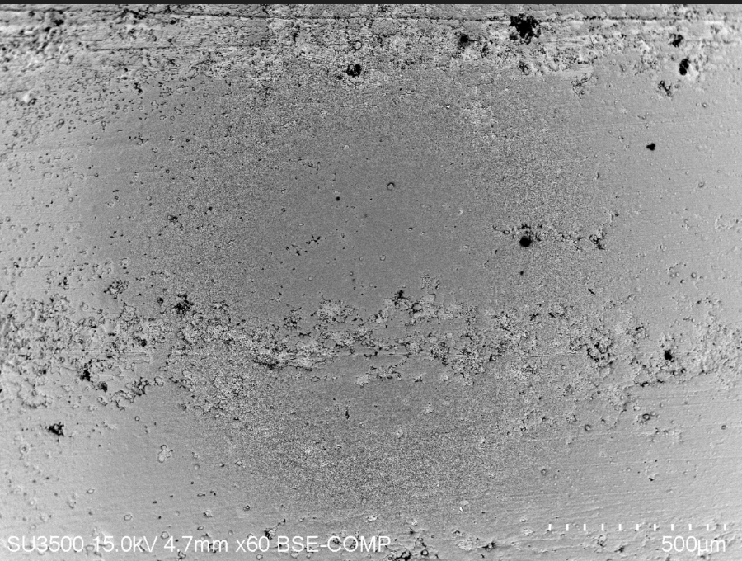
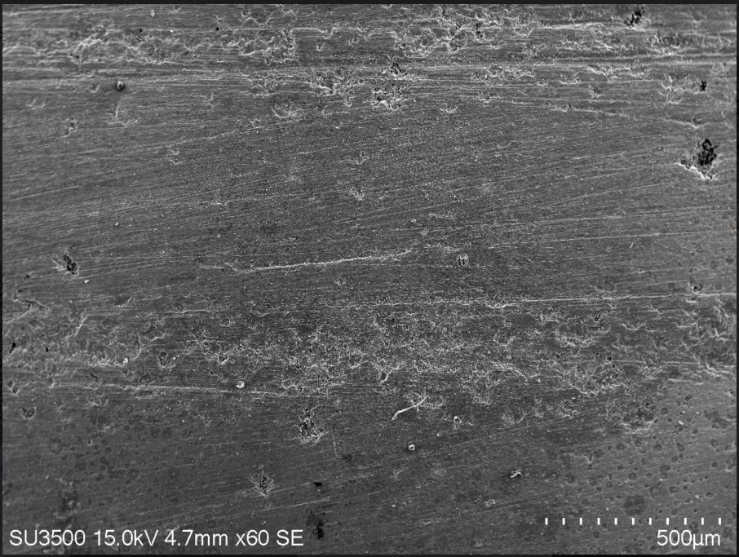
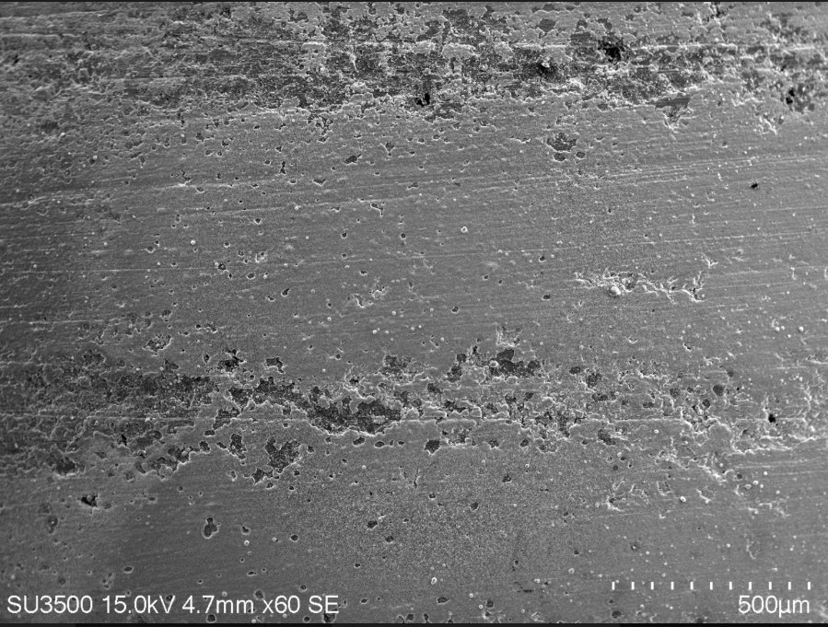
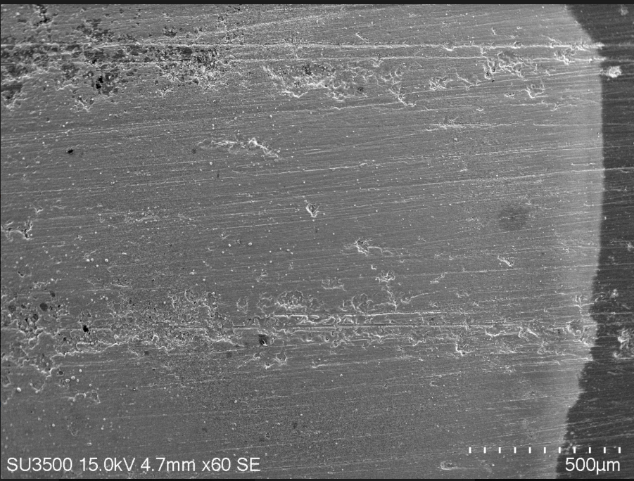
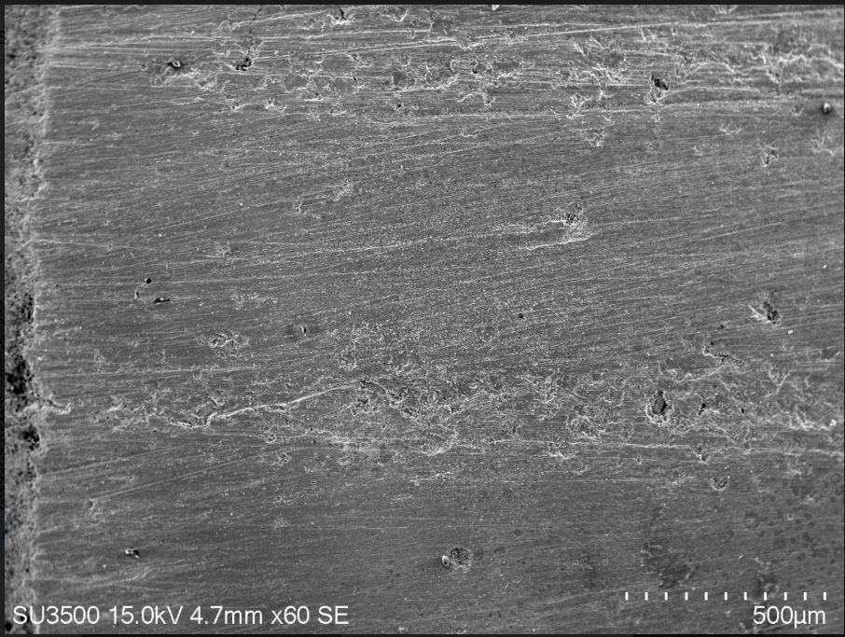
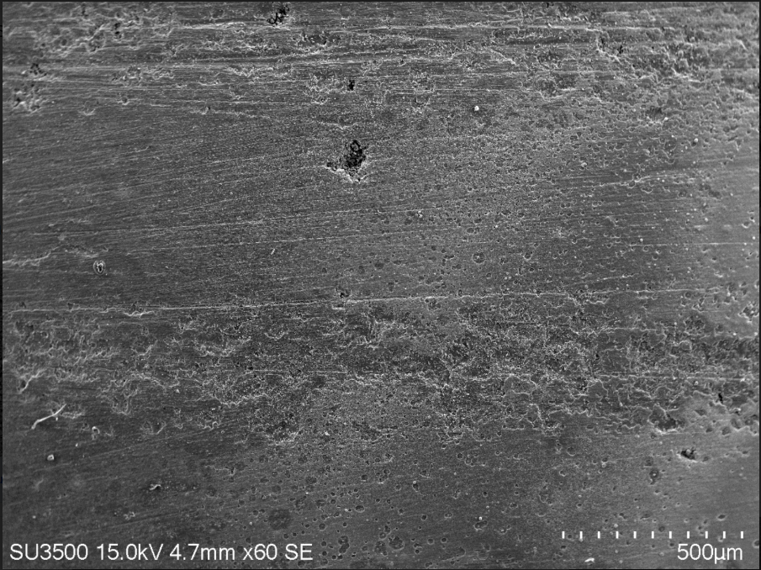
BSE
Origin

Slide 21
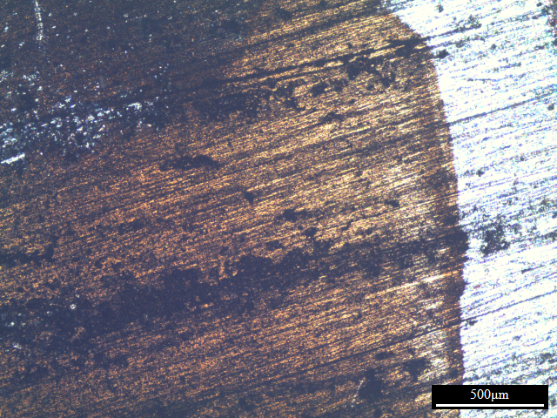
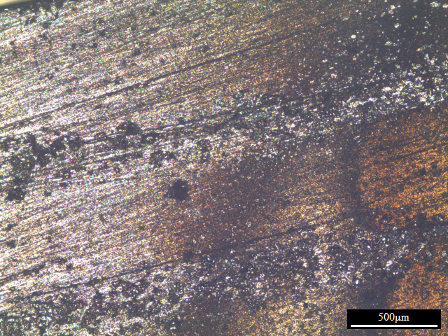
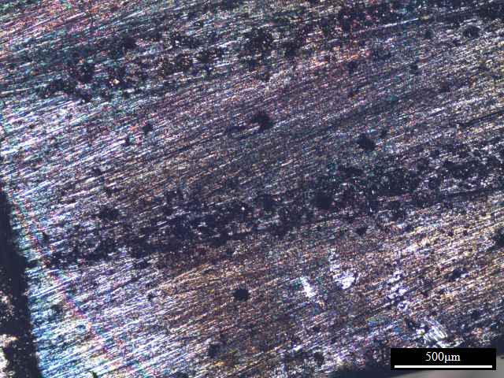
SEM
OM

Slide 22
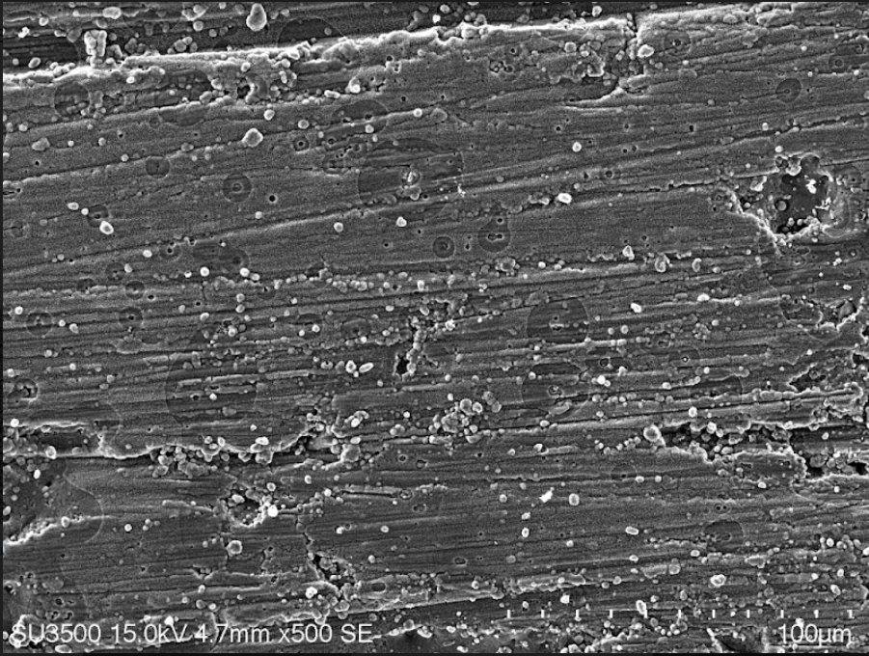
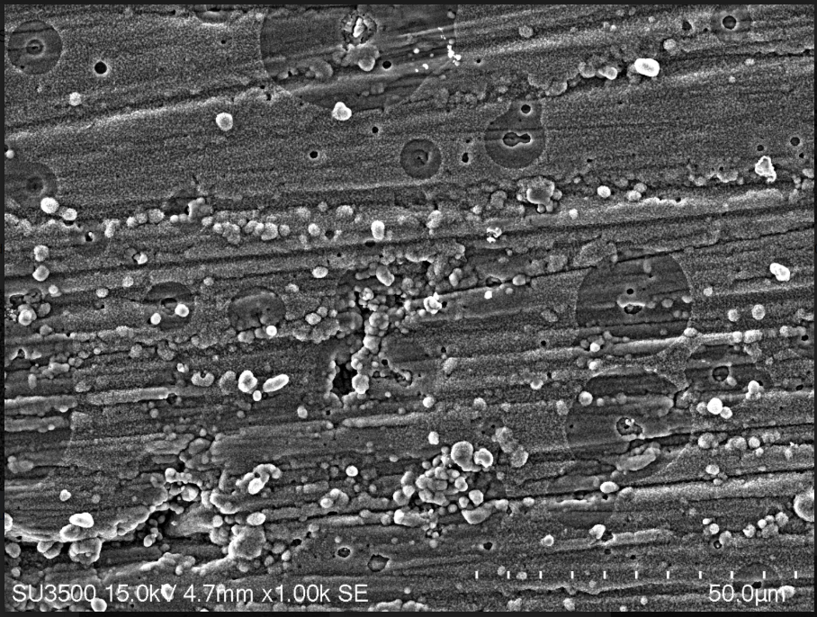
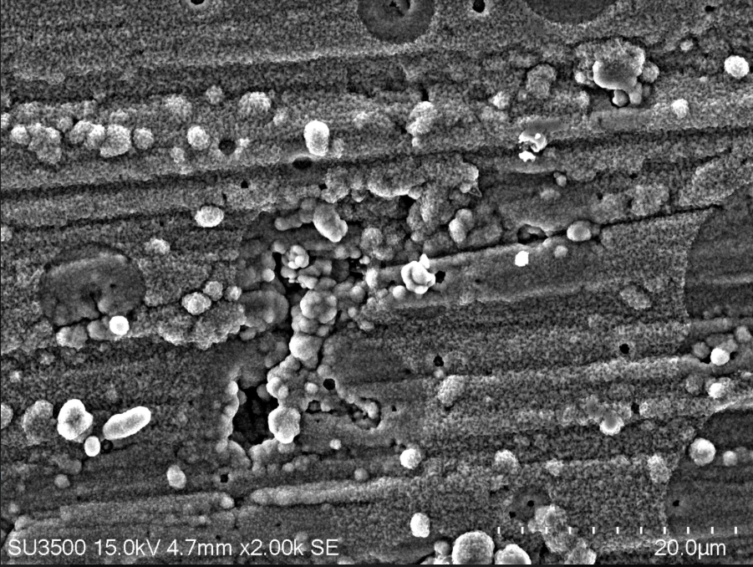
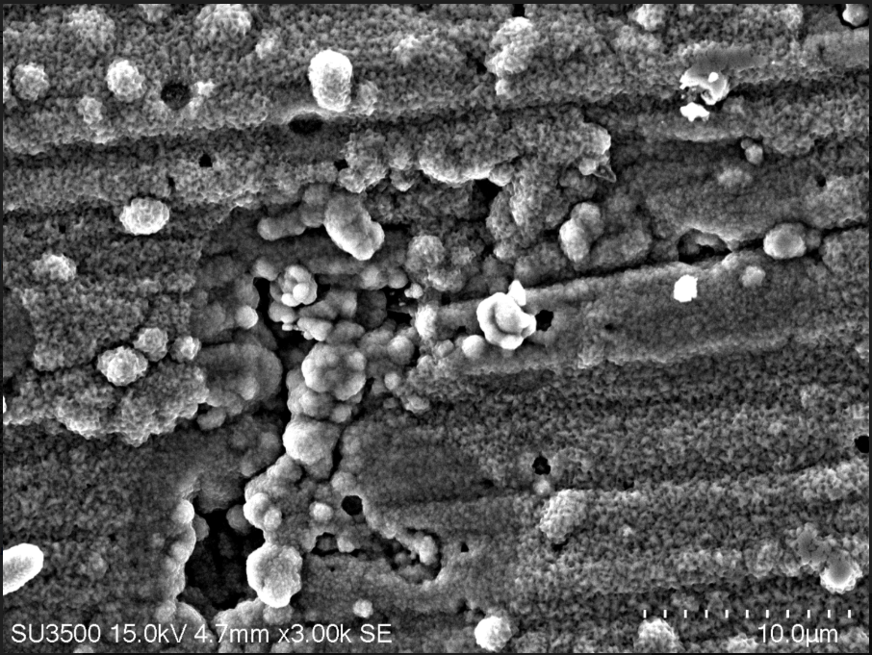
SE-anode
500~3000x

Slide 23
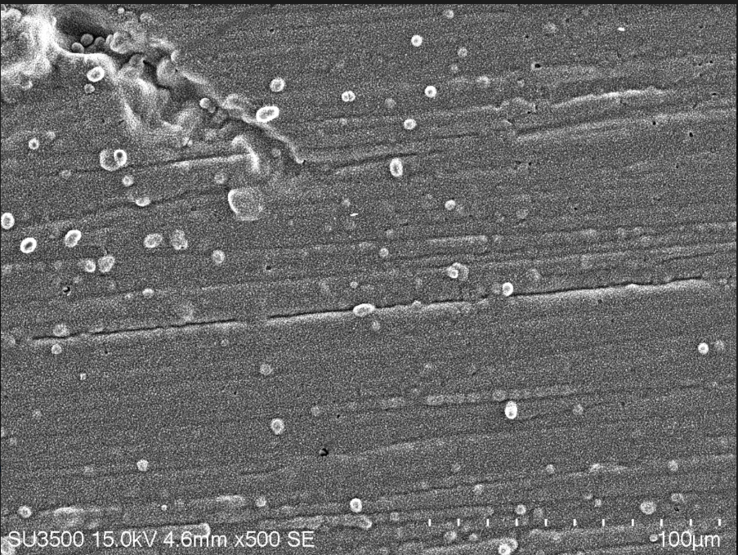
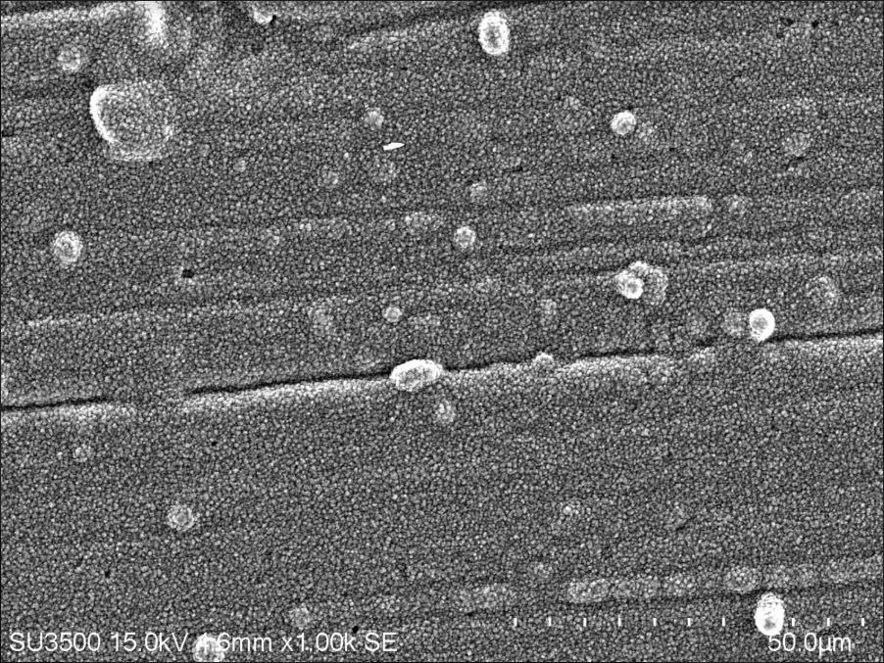
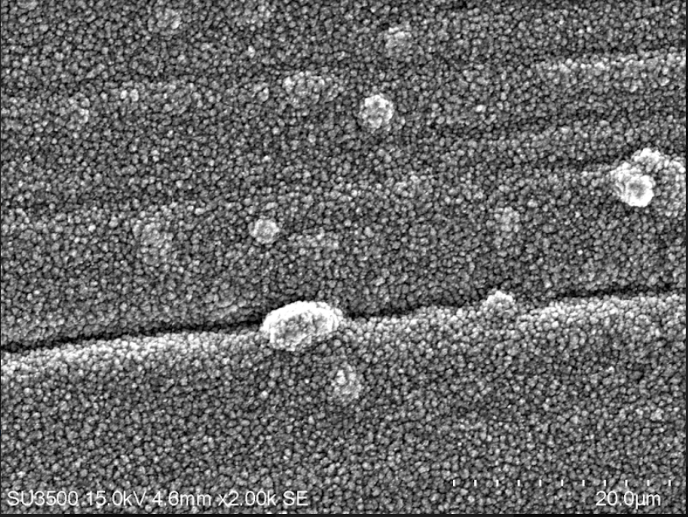
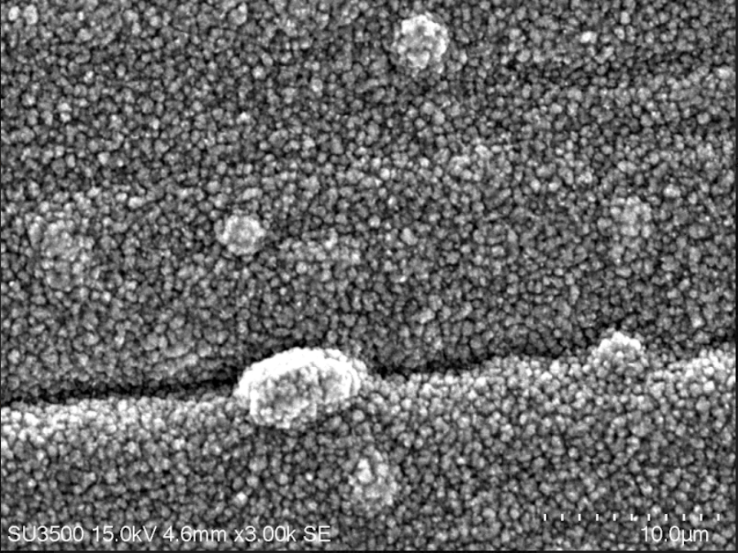
SE-cathode
500~3000x

Slide 24
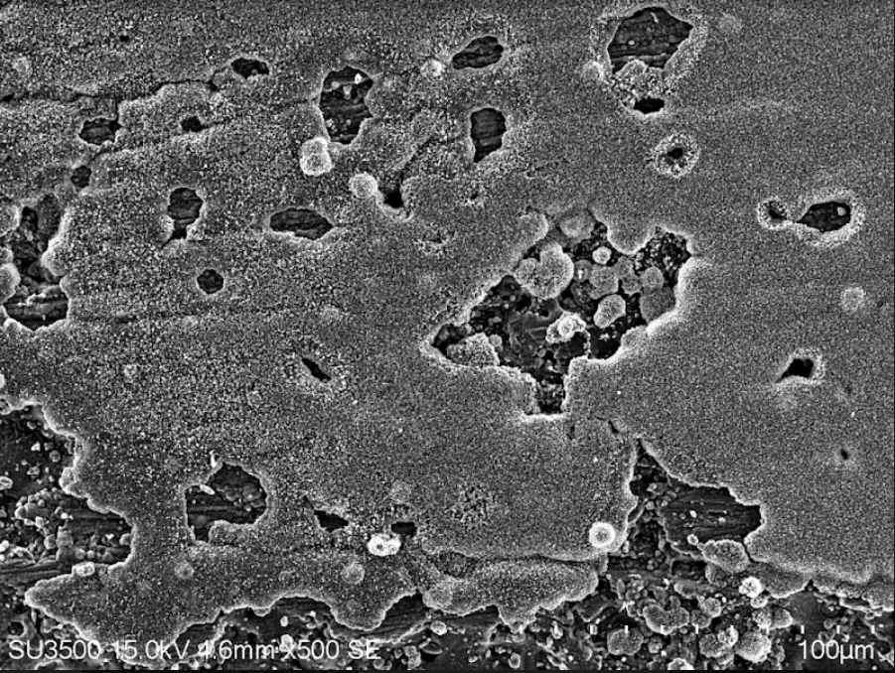
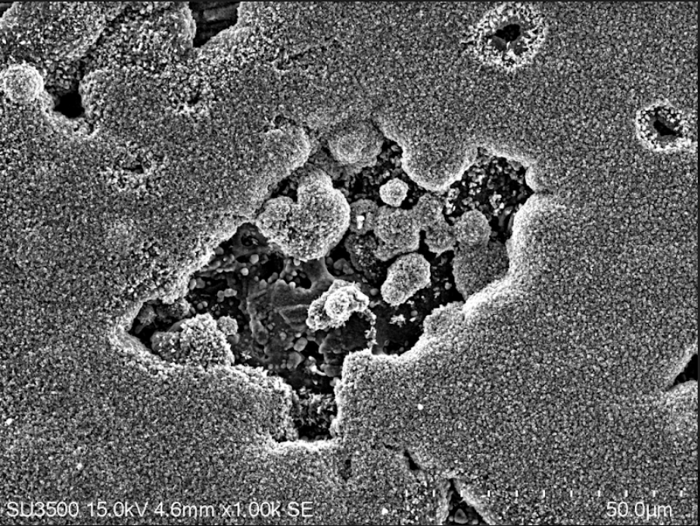
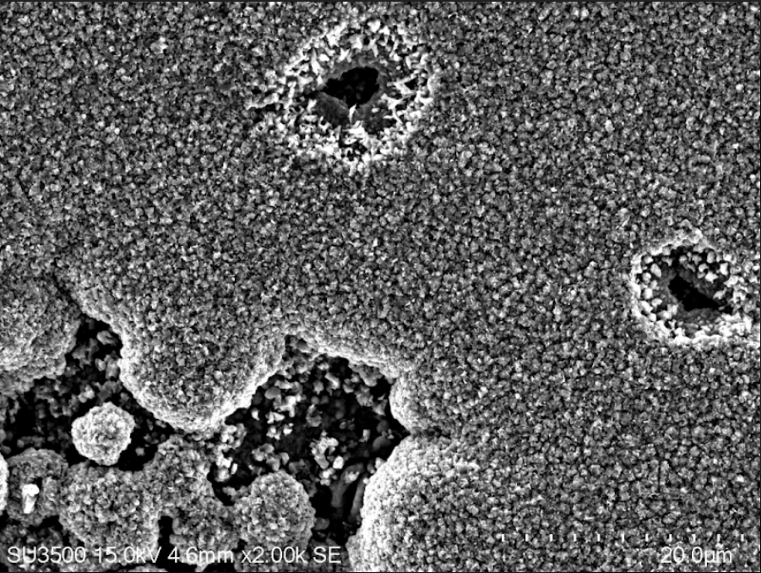
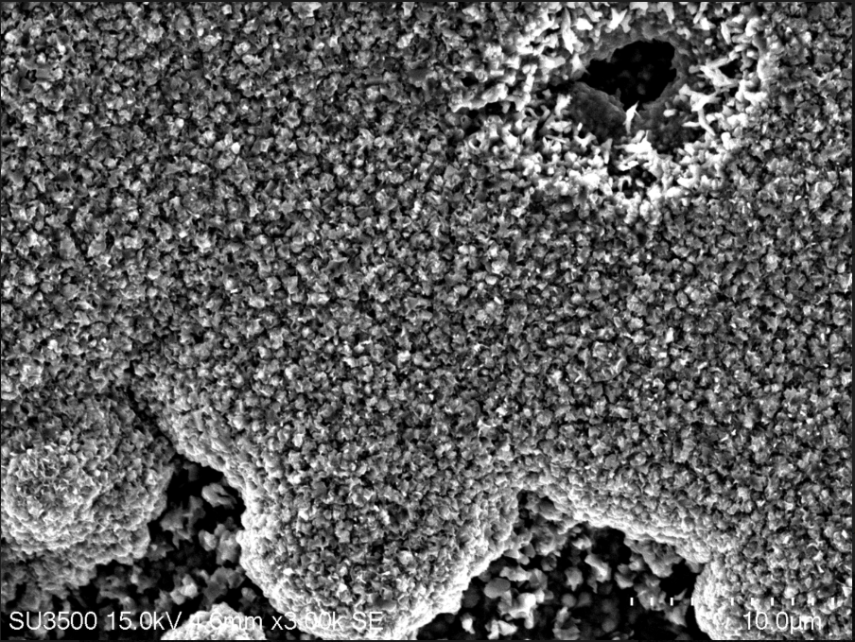
SE-middle
500~3000x

Slide 25
EDS

Slide 26
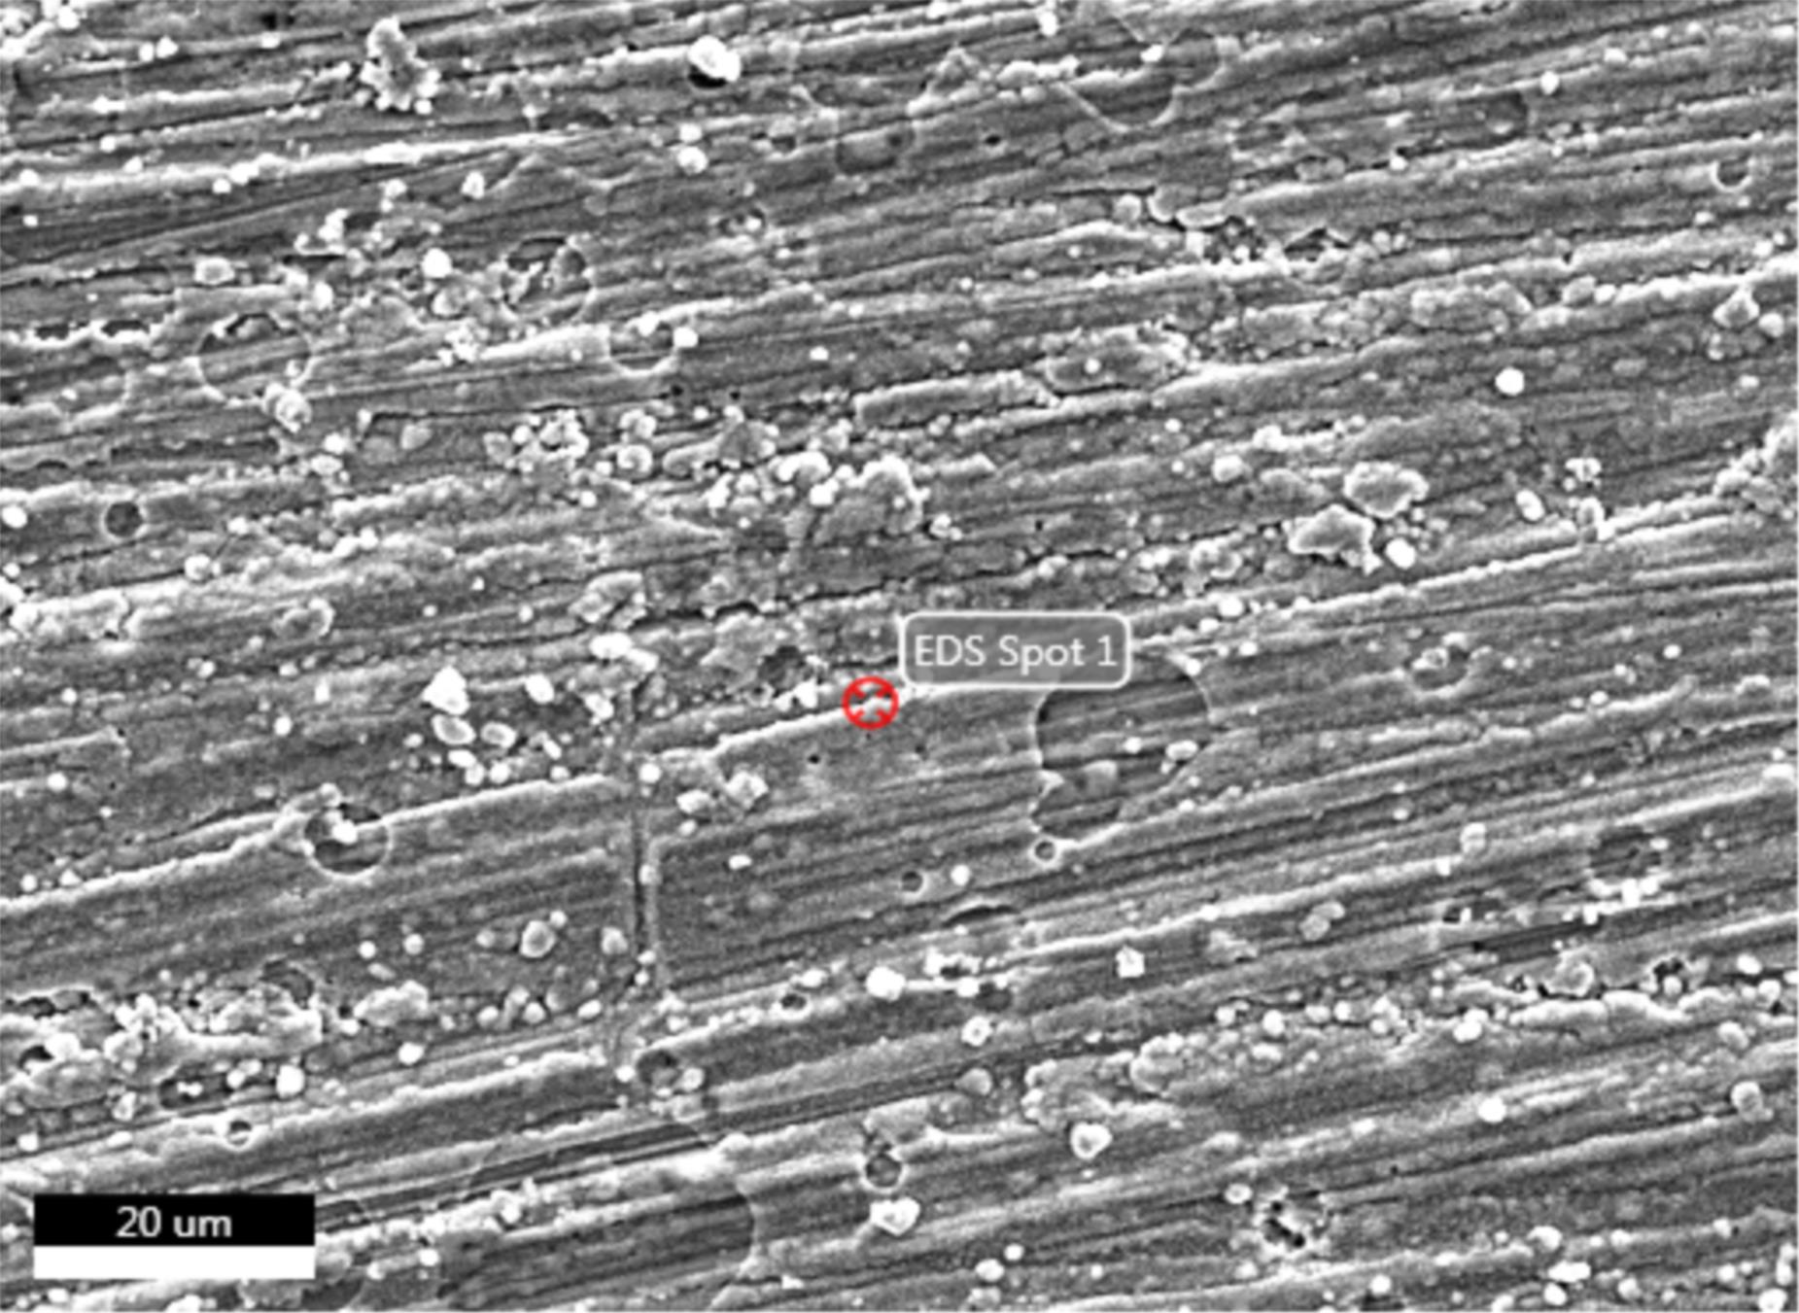
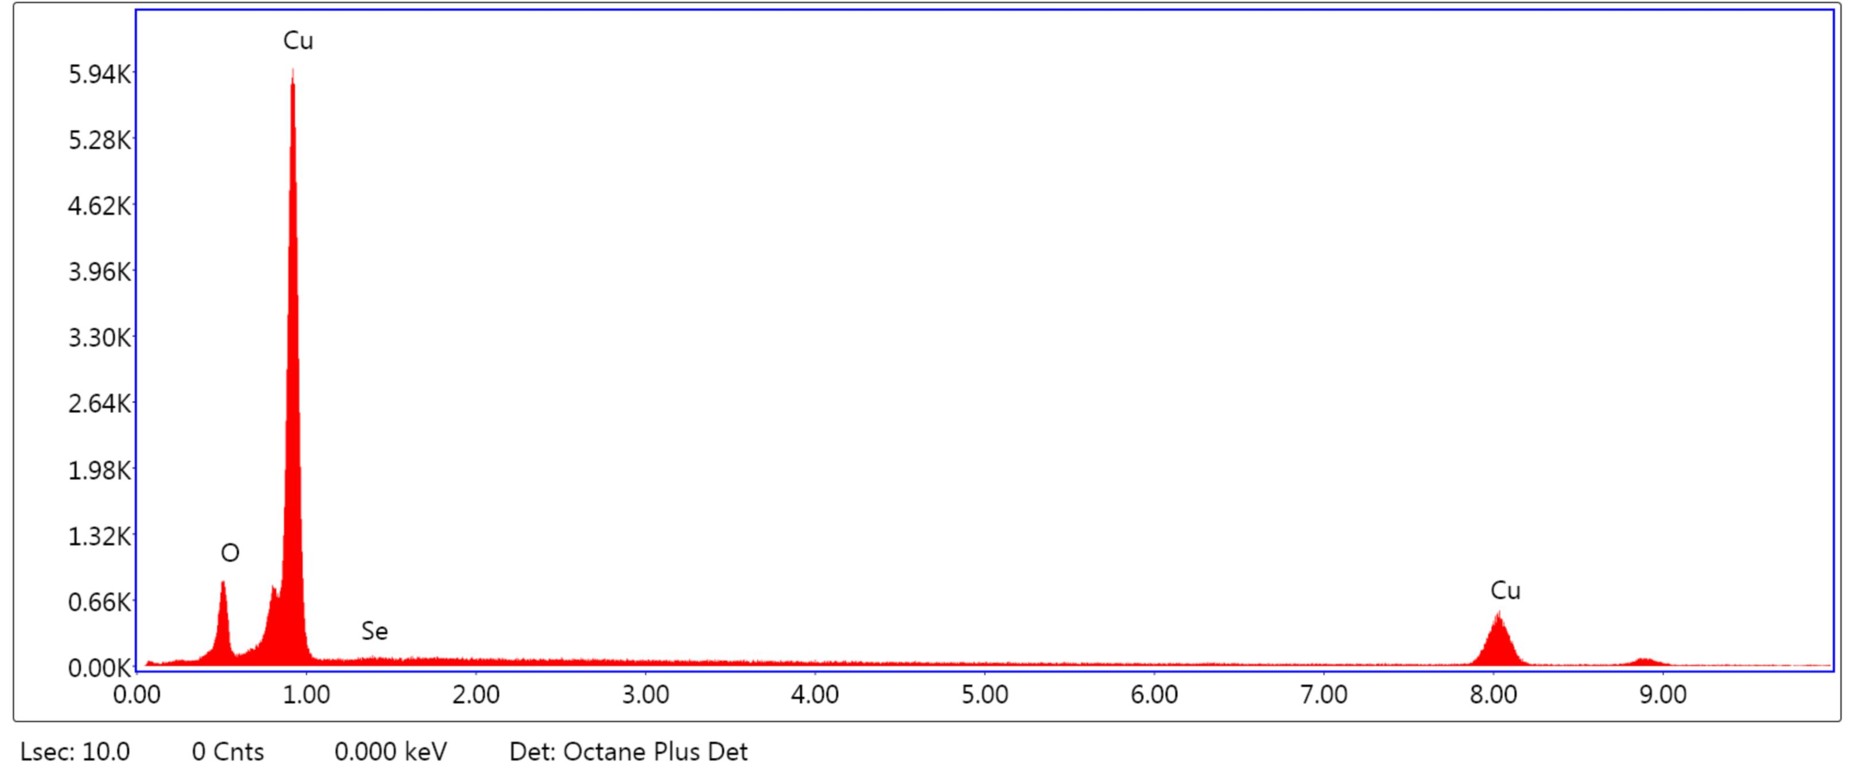
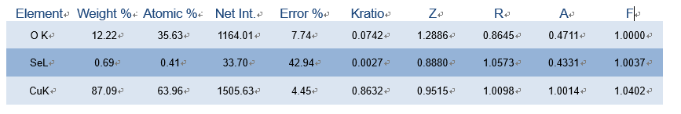
Anode

Slide 27
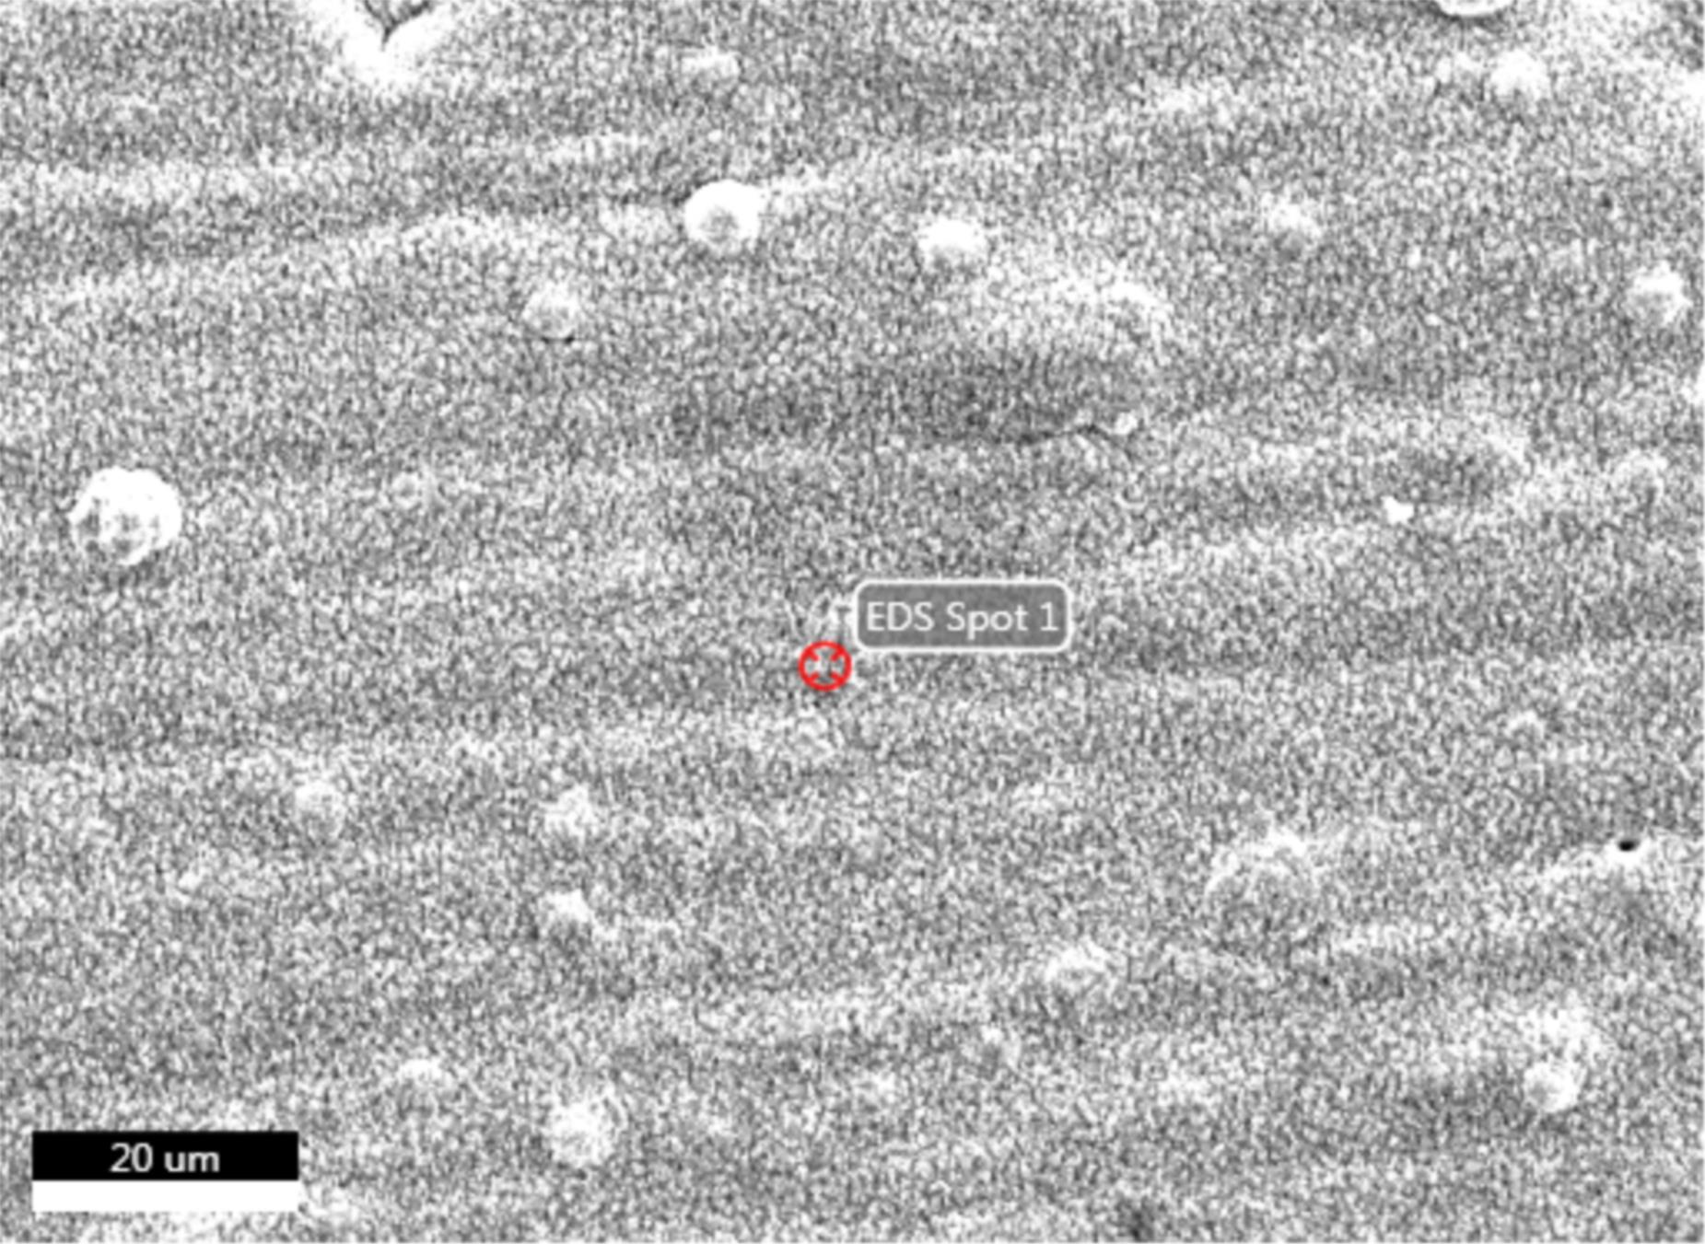
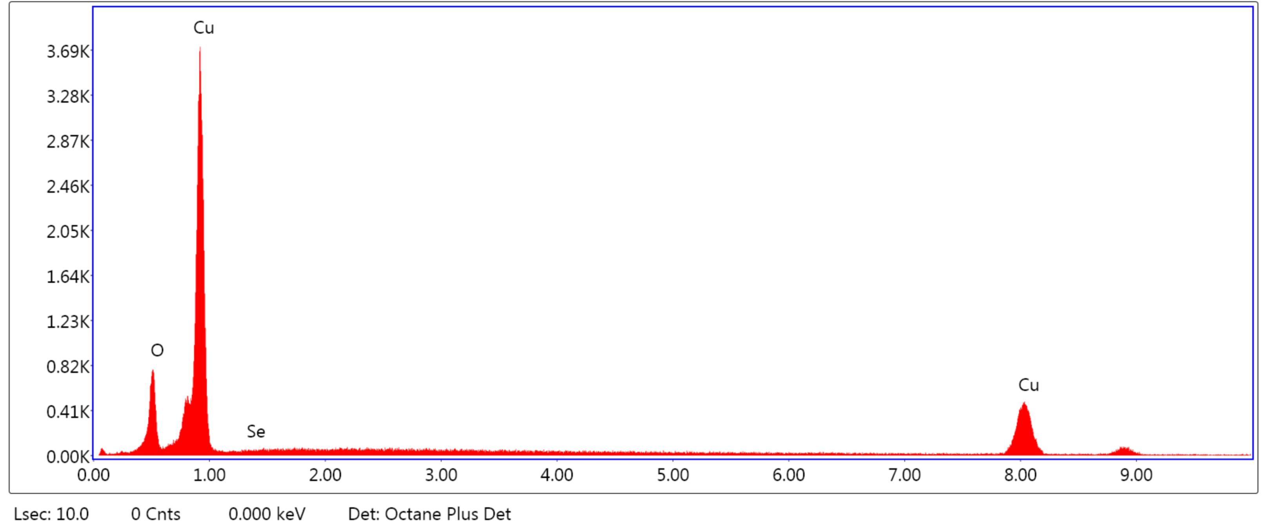

Cathode

Slide 28



Middle

Slide 29
Problems&
improvement

Slide 30
improvement
1.Peak form 10~80 measured ,peak of 13 degree is very high
2.Stable heat dissipation and detecting temperature by Thermocouple
3. Anaerobic condition &improving electric conducting method
4. Do pure heating & heating+conducting (non-equilibrium too)
5. Precisely measuring time to calculate diffusion(structure changing)
6.氮氣瓶不足噴所有試片(做皮箱)照XRD

Slide 31
Anode

Slide 32
Cathode

Slide 33
Middle

